Slide 1
Jpeg compression
Presented By
Anmol Sharma (23EC65R02)
Ajay Kumar Mahto(23EC65R16)

Slide 2
What is Image Compression?
The objective of image compression is to reduce irrelevant and redundant image data in order to be able to store or transmit data in an efficient form.

Slide 3
Types
Lossless image compression is a compression algorithm that allows the original image to be perfectly reconstructed from the original data.
Lossy image compression is a type of compression where a certain amount of information is discarded which means that some data are lost and hence the image cannot be decompressed with 100% originality.
Image Compression
Lossless
Lossy

Slide 4
Overview
JPEG, which stands for Joint Photographic Experts Group (the name of the committee that created the JPEG standard) is a lossy compression algorithm for images.
A lossy compression scheme is a way to inexactly represent the data in the image, such that less memory is used yet the data appears to be very similar. This is why JPEG images look almost the same as the original images they were derived from most of the time, unless the quality is reduced significantly, in which case there will be visible differences.
The JPEG algorithm takes advantage of the fact that humans can't see colors at high frequencies. These high frequencies are the data points in the image that are eliminated during the compression. JPEG compression also works best on images with smooth color transitions.

Slide 5
What is JPEG compression?
﻿JPEG is a commonly used method of lossy compression for digital images. The degree of compression can be adjusted, allowing a tradeoff between storage size and image quality with a compression ratio 10:1; but with little perceptible loss in image quality.

Slide 6
Why JPEG?
﻿JPEG uses transform coding, it is largely based on the following observations:
A large majority of useful image contents change relatively slowly across images, i.e., it is unusual for intensity values to alter up and down several times in a small area, for example, within an 8 x 8 image block. A translation of this fact into the spatial frequency domain, implies, generally, lower spatial frequency components contain more information than the high frequency components which often correspond to less useful details and noises.
Experiments suggest that humans are more immune to loss of higher spatial frequency components than loss of lower frequency components. Human vision is insensitive to high frequency components.

Slide 7
JPEG Schematic
﻿
De- quantization
Inverse DCT
Colour Transform
Decoding
Down- sampling
Up-sampling
JPEG Decompression
JPEG Compression
Forward DCT
Compressed image data
Colour Transform
Quantization
Encoding

Slide 8
Algorithm
Splitting: Split the image into 8 x 8 non-overlapping pixel blocks. If the image cannot be divided into 8-by-8 blocks, then you can add in empty pixels around the edges, essentially zero-padding the image.
Colour Space Transform from [R,G,B] to [Y, Cb, Cr] & Subsampling.
DCT: Take the Discrete Cosine Transform (DCT) of each 8-by-8 block.
Quantization: quantize the DCT coefficients according to psycho-visually tuned quantization tables.
Serialization: by zigzag scanning pattern to exploit redundancy.
Vectoring: Differential Pulse Code Modulation (DPCM) on DC components Run Length Encoding (RLE) on AC components
Entropy Coding:
Run Length Coding
Huffman Coding or Arithmetic Coding

Slide 9
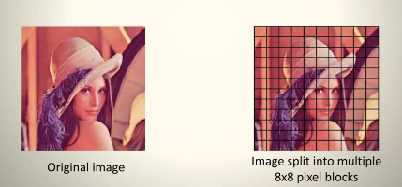
Step 1 - Splitting
﻿The input image is divided into smaller blocks having 8 x 8 dimensions, summing up to 64 units in total. Each of these units is called a pixel, which is the smallest unit of any image.

Slide 10
Step II - RGB to YCbCr conversion
JPEG makes use of [Y, Cb, Cr] model instead of [R,G,B] model.
The precision of colors suffer less (for a human eye) than the precision of contours (based on luminance)
Simple color space model: [R,G,B] per pixel
JPEG uses [Y, Cb, Cr] Model
Y = Brightness
Cb = Color blueness
Cr = Color redness

Slide 11
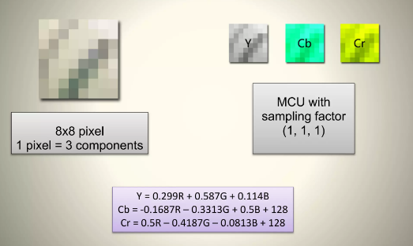
Colour conversion

Slide 12
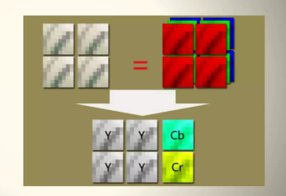
Down-sampling
Y is taken for every pixel, and Cb,Cr are taken for a block of 2x2 pixel.
MCU=Minimum Coded Unit (smallest unit that can be coded)
Data size reduces to half.
4 blocks
16x16 pixel
MCU with sampling factor (2,1,1)

Slide 13
Step III - Forward DCT
The DCT uses the cosine function, therefore not interacting with complex numbers at all.
DCT converts the information contained in a block(8x8) of pixels from spatial domain to the frequency domain.
Why DCT?
Human vision is insensitive to high frequency components, due to which it is possible to treat the data corresponding to high frequencies as redundant. To segregate the raw image data on the basis of frequency, it needs to be converted into frequency domain, which is the primary function of DCT.

Slide 14
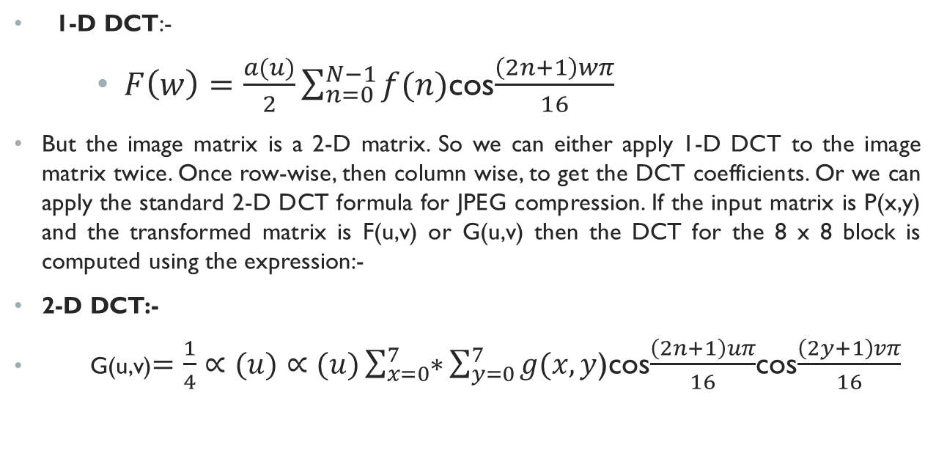
DCT Formula
1-D DCT:-
$F\left(w\right)=\frac{a(u)}{2}\sum_{n=0}^{N−1}{f(n)}$cos$\frac{\left(2n+1\right)wπ}{16}$
But the image matrix is a 2-D matrix. So we can either apply 1-D DCT to the image matrix twice. Once row-wise, then column wise, to get the DCT coefficients. Or we can apply the standard 2-D DCT formula for JPEG compression. If the input matrix is P(x,y) and the transformed matrix is F(u,v) or G(u,v) then the DCT for the 8 x 8 block is computed using the expression:-
2-D DCT:-
G(u,v)$=\frac{1}{4}∝(u)∝(u)\sum_{x=0}^{7}{∗}\sum_{y=0}^{7}{g(x,y}$)cos$\frac{\left(2n+1\right)uπ}{16}$cos$\frac{\left(2y+1\right)vπ}{16}$

Slide 15
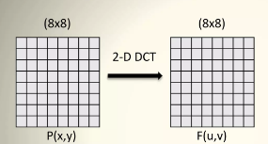
DC and AC components
﻿
F(0,0) is called the DC components and
and the rest of P(x,y) are called AC
components.
For u = v = 0 the two cosine terms are 0 and hence the value in the location F[0,0] of the transformed matrix is simply a function of the summation of all the values in the input matrix.
This is the mean of all 64 values in the matrix and is known as the DC coefficient.
Since the values in all the other locations of the transformed matrix have a frequency coefficient associated with them they are known as AC coefficients.

Slide 16
Step IV - Quantization
Humans are unable to see aspects of an image that are at really high frequencies. Since taking the DCT allows us to isolate where these high frequencies are, we can take advantage of this in choosing which values to preserve. By multiplying the DCT matrix by some mask, we can zero out elements of the matrix, thereby freeing the memory that had been representing those values.
The resultant quantize matrix will only preserve values at the lowest frequencies up to a certain point.
Why Quantization?
To reduce the number of bits per sample.
Two types:-
Uniform quantization
q(u,v) is a constant
Non-uniform quantization
Custom quantization tables can be put in image/scan header.
JPEG Standard defines two default quantization tables, one each for luminance and chrominance.

Slide 17
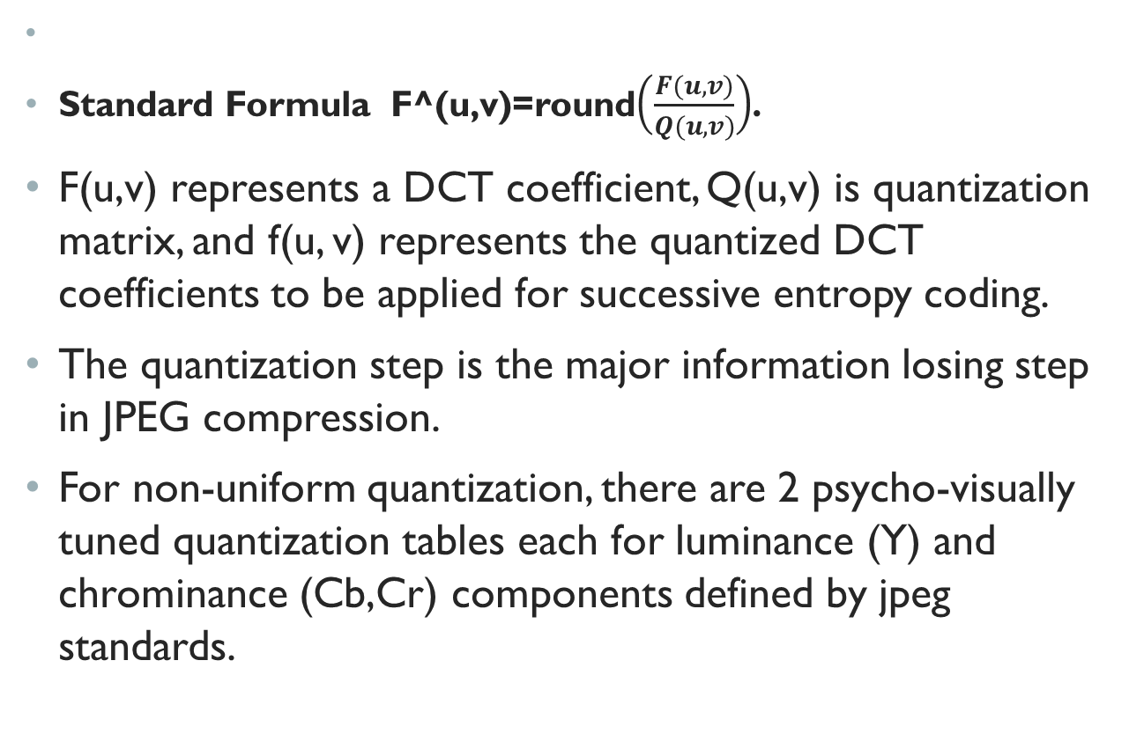
quantization
﻿
Standard Formula F^(u,v)=round$\left(\frac{F(u,v)}{Q(u,v)}\right)$.
F(u,v) represents a DCT coefficient, Q(u,v) is quantization matrix, and f(u, v) represents the quantized DCT coefficients to be applied for successive entropy coding.
The quantization step is the major information losing step in JPEG compression.
For non-uniform quantization, there are 2 psycho-visually tuned quantization tables each for luminance (Y) and chrominance (Cb,Cr) components defined by jpeg standards.

Slide 18
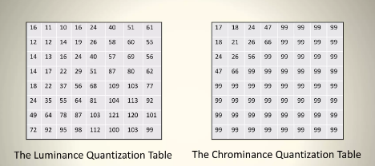
quantization
The entries of Q(u,v) tend to have larger values towards the lower right corner. This aims to introduce more loss at the higher spatial frequencies.
The tables above show the default Q(u,v) values obtained from psychophysical studies with the goal of maximizing the compression ratio while minimizing perceptual losses in JPEG images.

Slide 19
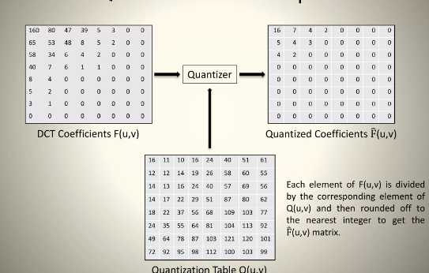
Quantization-example

Slide 20
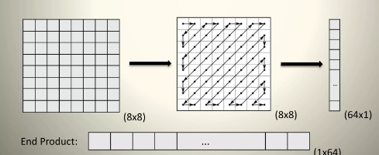
Step V-Zig-Zag Scan
Maps 8 x 8 matrix to a 1 x 64 vector.
Why zigzag scanning?
To group low frequency coefficients at the top of the vector and high frequency coefficients at the bottom.
In order to exploit the presence of the large number of zeros in the quantized matrix, a zigzag of the matrix is used.

Slide 21
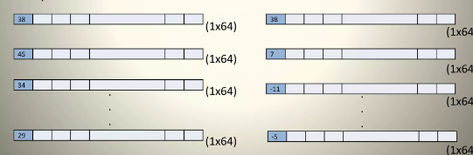
Step VI - Vectoring: DPCM on DC component
﻿Differential Pulse Code Modulation (DPCM) is applied to the DC component.
DC component is large and varies, but often close to previous value.
DPCM encodes the difference between the current and previous 8x8 block.
The entropy coding operates on a 1-dimensional string of values (vector). However the output of the quantization matrix is a 2-D matrix and hence this has to be represented in 1 D form. This is known as Vectoring.
Example:-

Slide 22
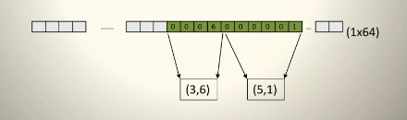
Step VII - RLE on AC components
Run Length Encoding (RLE) is applied to the AC components.
1x63 vector (AC) has lots of zeros in it.
Encoded as (skip, value) pairs, where skip is the number of zeros preceding a non-zero value in the quantized matrix, and value is the actual coded value of the non-zero component.
(0,0) is sent as end-of-block (EOB) sentinel value and the zeros after that are discarded. Only the number of zeros is taken note of.

Slide 23
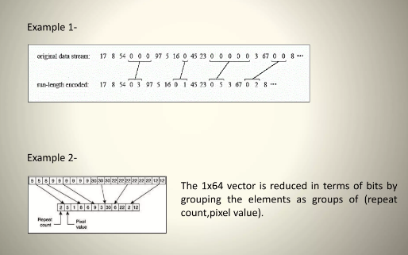
Rle examples

Slide 24
Step VIII - Huffman Coding
﻿ DC and AC components finally need to be represented by a smaller number of bits
Why Huffman Coding?
Significant levels of compression can be obtained by replacing long strings of binary digits by a string of much shorter code words.
• How?
The length of each code word is a function of its relative frequency of occurrence. Normally a table of code words is used with the set of code words pre- computed using the Huffman Coding Algorithm.
In Huffman Coding, each DPCM-coded DC coefficient is represented by a pair of symbols: (Size, Amplitude)
where Size indicates number of bits needed to represent the coefficient and Amplitude contains actual bits.

Slide 25
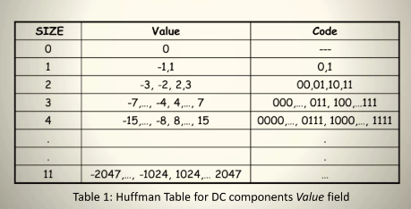
Huffman coding: dc components
DC components are coded as (Size, Value).The look –up table for generating code word for value is as given below :-

Slide 26
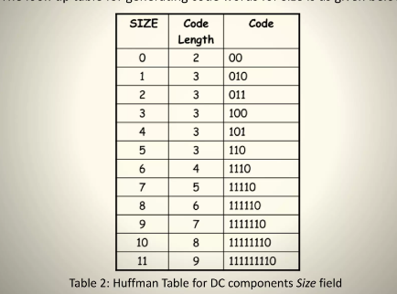
Huffman coding – DC components
The look-up table for generating code word for size is as given below:-

Slide 27
Huffman DC Coding - Example
If the DC component is 48, and the previous DC component is 52. Then the difference between the 2 components is (48-52) = -4.
Therefore it is Huffman coded as: 100011
011: The codes for representing -4 (Table 1.)
100: The size of the value code word is 3. From Table 2, code corresponding to 3 is 100.

Slide 28
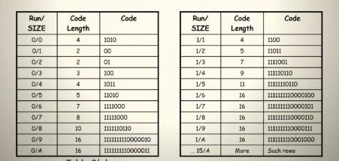
Huffman Coding: AC Components
AC components are coded in two parts:
Part1: (RunLength/SIZE)
RunLength: The length of the consecutive zero values (0.15]
SIZE: The number of bits needed to code the next nonzero
AC component's value. [0-A]
(0,0) is the End Of Block (EOB) for the 8x8 block.
Part1 is Huffman coded (see Table 3)
Part2: (Value)
Value: Is the actual value of the AC component.(Table 1)

Slide 29
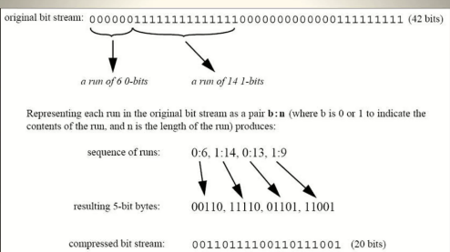
Example of Run length encoding

Slide 30
Merits of JPEG Compression
﻿Works with colour and grayscale images, but not with binary images.
Up to 24 bit colour images (Unlike GIF)
Target photographic quality images (Unlike GIF)
Suitable for many applications e.g., satellite, medical, general photography, etc.

Slide 31
conclusion
Lossy compression method used for digital images.
Divides the image into blocks of pixels.
Applies discrete cosine transform (DCT) to these blocks.
Quantizes the frequency information based on human perception.
Discards some data based on quantization to reduce file size.
Compresses images with minimal visual quality loss.
Commonly used for photographs and complex images.
Not ideal for images that require high precision and no loss, like medical imaging.

Slide 32
Thank you

